Slide 1



Slide 2
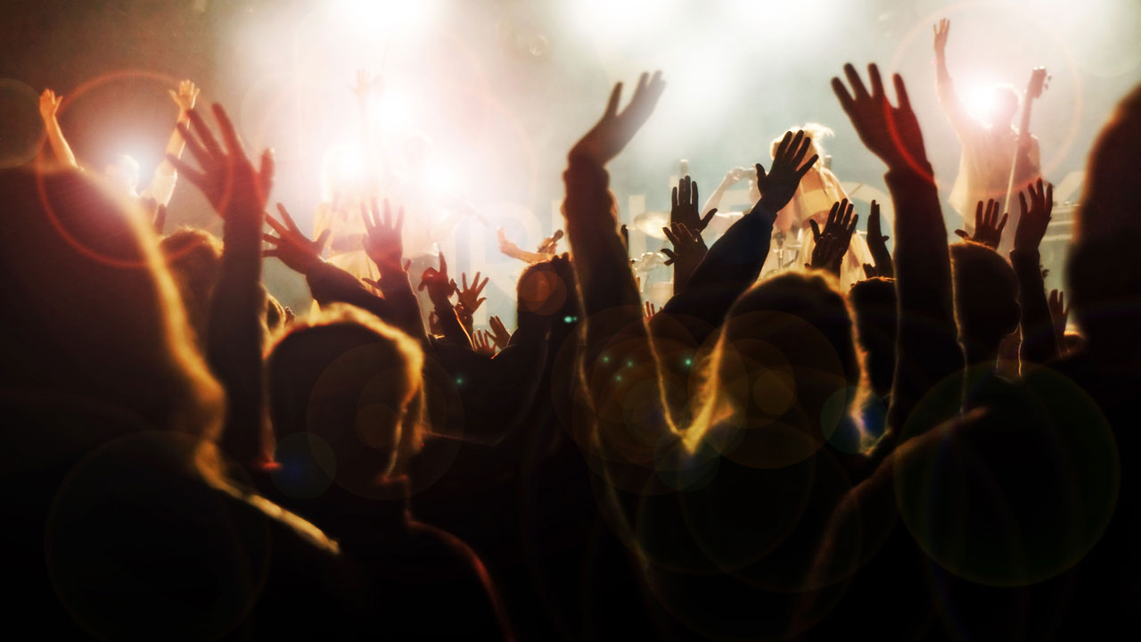
Let It Rise

Slide 3
Let the Glory of the Lord rise among us
Let the Glory of the Lord rise among us

Slide 4
Let the praises of the King rise among us,
let it rise

Slide 5
Let the songs of the Lord rise among us
Let the songs of the Lord rise among us

Slide 6
Let the joy of the King rise among us,
let it rise

Slide 7
Oh, let it rise
Oh, let it rise

Slide 8
Let the Glory of the Lord rise among us
Let the Glory of the Lord rise among us

Slide 9
Let the praises of the King rise among us,
let it rise

Slide 10
Oh, Let it rise
Oh, Let it rise

Slide 11
Let the Glory of the Lord rise among us
Let the Glory of the Lord rise among us

Slide 12
Let the praises of the King rise among us,
let it rise

Slide 13
Oh, Let it rise
Oh, Let it rise

Slide 15
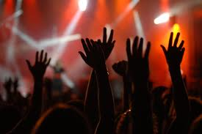
I Am Free

Slide 16
Through You the blind will see
Through You the mute will sing
Through You the dead will rise
Through You all hearts will praise
Through You the darkness flees
Through You my heart screams
I am free

Slide 17
I am free to run
(I am free to run)
I am free to dance
(I am free to dance)
I am free to live for You
(I am free to live for You)
I am free
(I am free)
(repeat)

Slide 18
Through You the blind will see
Through You the mute will sing
Through You the dead will rise
Through You all hearts will praise
Through You the darkness flees
Through You my heart screams
I am free

Slide 19
I am free to run
(I am free to run)
I am free to dance
(I am free to dance)
I am free to live for You
(I am free to live for You)
I am free
(I am free)
(repeat)

Slide 22
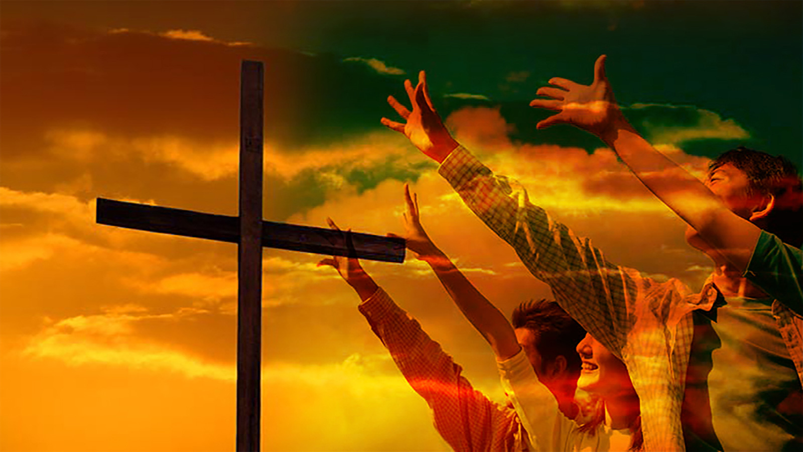
Here I Am to Worship

Slide 23
Light of the world, You stepped down into darkness.
Opened my eyes let me see.
Beauty that made this heart adore you
Hope of a life spent with You.

Slide 24
And here I am to worship,
Here I am to bow down,
Here I am to say that You're my God,
You're altogether lovely,
Altogether worthy,
Altogether wonderful to me.

Slide 25
King of all days,
Oh so highly exalted Glorious in heaven above.
Humbly You came to the earth You created.
All for love's sake became poor.

Slide 26
And here I am to worship,
Here I am to bow down,
Here I am to say that You're my God,
You're altogether lovely,
Altogether worthy,
Altogether wonderful to me.

Slide 27
I'll never know how much it cost
to see my sin upon that cross. (2x)

Slide 28
Here I am to worship,
Here I am to bow down,
Here I am to say that You're my God,
You're altogether lovely,
Altogether worthy,
Altogether wonderful to me.

Slide 29
So Here I am to worship,
Here I am to bow down,
Here I am to say that You're my God

Slide 31
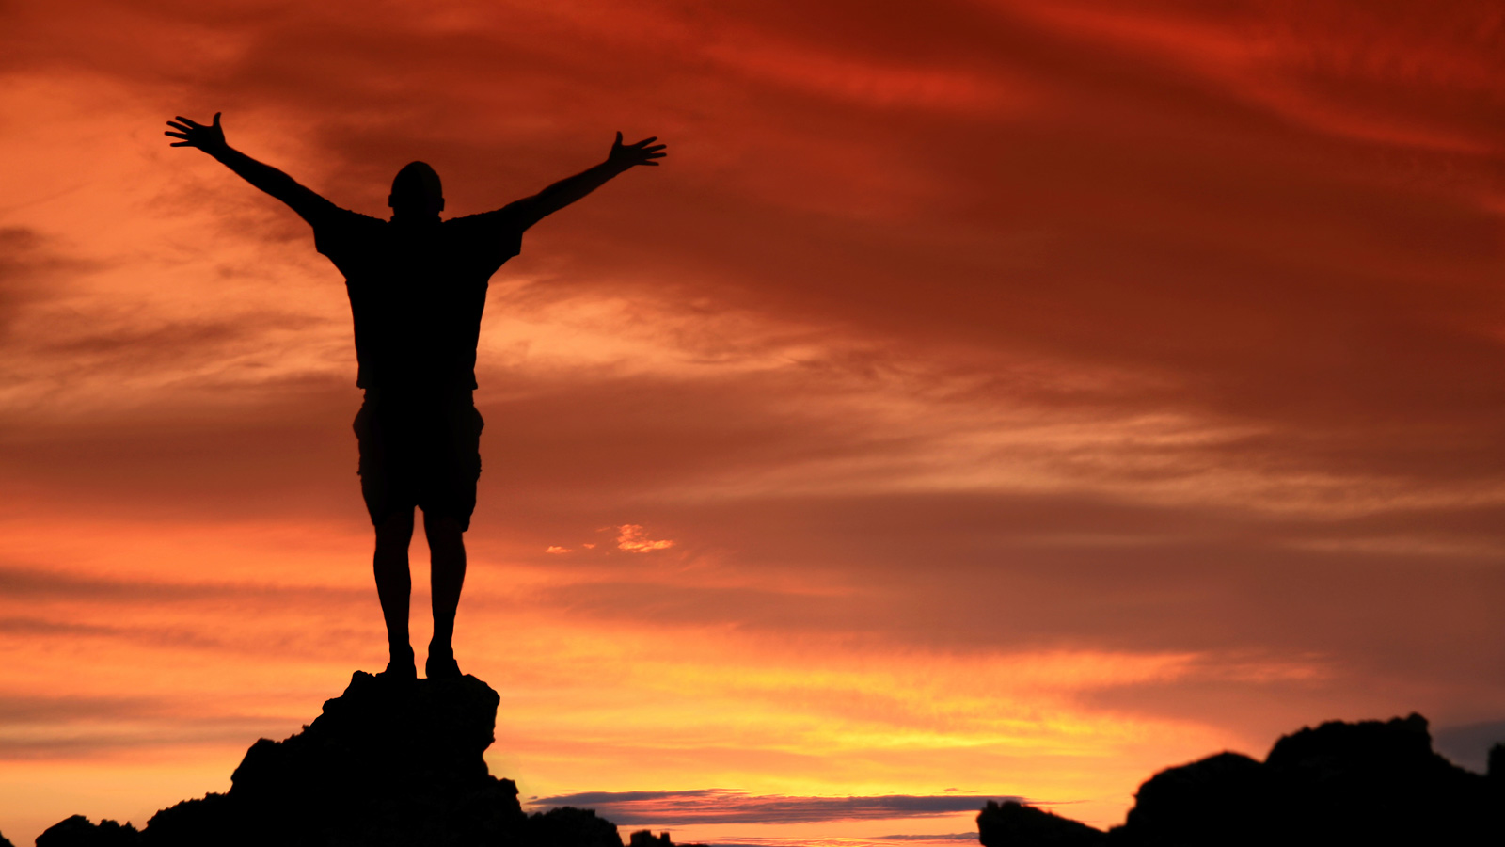
Revelation Song

Slide 32
Worthy is the Lamb who was slain
Holy, Holy, is He
Sing a new song, to Him who sits on
Heaven's Mercy Seat

Slide 33
Worthy is the Lamb who was slain
Holy, Holy, is He
Sing a new song, to Him who sits on
Heaven's Mercy Seat

Slide 34
Holy, Holy, Holy
Is the Lord God Almighty
Who was, and is, and is to come

Slide 35
With all creation I sing
Praise to the King of Kings
You are my everything
And I will adore You

Slide 36
Clothed in rainbows of living color
Flashes of lightning, rolls of thunder

Slide 37
Blessing and honor, strength and
Glory and power be
To You the Only Wise King

Slide 38
Holy, Holy, Holy
Is the Lord God Almighty
Who was, and is, and is to come

Slide 39
With all creation I sing
Praise to the King of Kings
You are my everything
And I will adore You

Slide 40
Filled with wonder,
Awestruck wonder
At the mention of Your Name

Slide 41
Jesus, Your Name is Power
Breath, and Living Water
Such a marvelous mystery

Slide 42
Holy, Holy, Holy
Is the Lord God Almighty
Who was, and is, and is to come

Slide 43
With all creation I sing
Praise to the King of Kings
You are my everything
And I will adore You

Slide 45
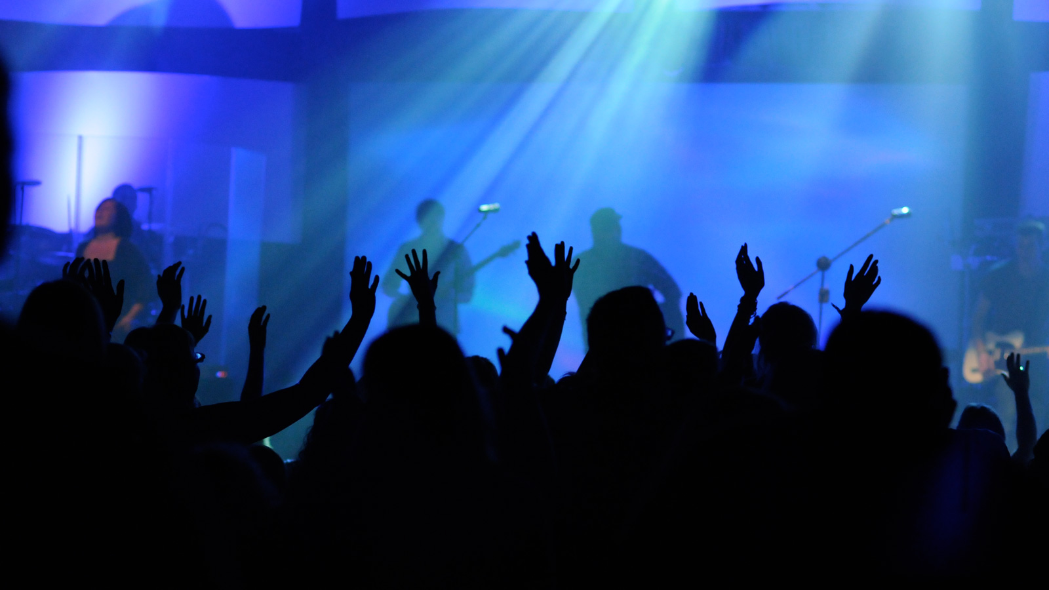
I See the Lord

Slide 46
I see the Lord
Seated on the throne exalted,
And the train of His robe
Fills the temple with glory

Slide 47
And the whole earth is filled
And the whole earth is filled
And the whole earth is filled
With His glory

Slide 48
I see the Lord
Seated on the throne exalted,
And the train of His robe
Fills the temple with glory

Slide 49
And the whole earth is filled
And the whole earth is filled
And the whole earth is filled
With His glory

Slide 50
Holy, Holy, Holy, Holy
Holy is the Lord
Holy, Holy, Holy, Holy
Holy is the Lord

Slide 51
I see the Lord
Seated on the throne exalted,
And the train of His robe
Fills the temple with glory

Slide 52
And the whole earth is filled
And the whole earth is filled
And the whole earth is filled
With His glory

Slide 54


Slide 55

Revelation 1:17-19 (NKJV)
¹⁷ And when I saw Him, I fell at His feet as dead. But He laid His right hand on me, saying to me, "Do not be afraid; I am the First and the Last.
¹⁸ I am He who lives, and was dead, and behold, I am alive forevermore. Amen. And I have the keys of Hades and of Death.
¹⁹ Write the things which you have seen, and the things which are, and the things which will take place after this.

Slide 57

1. HE IS THE ______________________________________
REIGNING ONE

Slide 58
Isaiah 41:4 (NKJV)
⁴ “Who has performed and done it, Calling the generations from the beginning? ' I, the LORD, am the first; And with the last I am He.' "
Isaiah 44:6 (NKJV)
⁶ "Thus says the LORD, the King of Israel, And his Redeemer, the LORD of hosts: 'I am the First and I am the Last; Besides Me there is no God.
Isaiah 48:12 (NKJV)
¹² "Listen to Me, O Jacob, And Israel, My called: I am He, I am the First, I am also the Last.

Slide 59
Isaiah 41:4 (NKJV)
⁴ “Who has performed and done it, Calling the generations from the beginning? ' I, the LORD, am the first; And with the last I am He.' "
Isaiah 44:6 (NKJV)
⁶ "Thus says the LORD, the King of Israel, And his Redeemer, the LORD of hosts: 'I am the First and I am the Last; Besides Me there is no God.
Isaiah 48:12 (NKJV)
¹² "Listen to Me, O Jacob, And Israel, My called: I am He, I am the First, I am also the Last.

Slide 61
2. HE IS THE ______________________________________
REDEEMED ONE

Slide 63
3. HE IS THE ______________________________________
RESURRECTED ONE

Slide 64
Philippians 2:8 (NKJV)
And being found in appearance as a man, He humbled Himself and became obedient to the point of death, even the death of the cross.

Slide 66
4. HE IS THE ______________________________________
REMAINING ONE

Slide 67
Hebrews 7:17 (NKJV)
For He testifies: "You are a priest forever According to the order of Melchizedek."
Hebrews 7:25 (NKJV)
Therefore He is also able to save to the uttermost those who come to God through Him, since He always lives to make intercession for them.

Slide 69
5. HE IS THE ______________________________________
RELEASING ONE

Slide 70
1 Thessalonians 4:13-18 (NKJV)
¹³ But I do not want you to be ignorant, brethren, concerning those who have fallen asleep, lest you sorrow as others who have no hope.
¹⁴ For if we believe that Jesus died and rose again, even so God will bring with Him those who sleep in Jesus.
¹⁵ For this we say to you by the word of the Lord, that we who are alive and remain until the coming of the Lord will by no means precede those who are asleep.

Slide 71
1 Thessalonians 4:13-18 (NKJV)
¹⁶ For the Lord Himself will descend from heaven with a shout, with the voice of an archangel, and with the trumpet of God. And the dead in Christ will rise first.
¹⁷ Then we who are alive and remain shall be caught up together with them in the clouds to meet the Lord in the air. And thus we shall always be with the Lord.
¹⁸ Therefore comfort one another with these words.

Slide 73
Above All

Slide 74
Above all powers
Above all kings
Above all nature
And all created things
Above all wisdom
And all the ways of man
You were here
Before the world began

Slide 75
Above all kingdoms
Above all thrones
Above all wonders
The world has ever known
Above all wealth
And treasures of the earth
There's no way to measure
What You're worth

Slide 76
Crucified
Laid behind a stone
You lived to die
Rejected and alone
Like a rose
Trampled on the ground
You took the fall
And thought of me
Above all

Slide 77
Above all powers
Above all kings
Above all nature
And all created things
Above all wisdom
And all the ways of man
You were here
Before the world began

Slide 78
Above all kingdoms
Above all thrones
Above all wonders
The world has ever known
Above all wealth
And treasures of the earth
There's no way to measure
What You're worth

Slide 79
Crucified
Laid behind a stone
You lived to die
Rejected and alone
Like a rose
Trampled on the ground
You took the fall
And thought of me
Above all

Slide 80
Like a rose
Trampled on the ground
You took the fall
And thought of me
Above all

Slide 82


Slide 83
ANNOUNCEMENTS

Slide 84
THIS EVENING!
6pm
Student Ministry
Black Tie Fund Raiser Dinner

Slide 85
LADIES BIBLE STUDY!
BEGINS MONDAY AUGUST 15th
PLEASE SEE MS. RUTH ANN FOR MORE INFORMATION

Slide 86


